Slide 1
Intermediate Python: Updating Anaconda Navigator
Data Structures, Algorithms & Object-Oriented Programming

Slide 2
Updating Anaconda Navigator
If you did not see the vscode “square” in the last lecture, then you need to update the Anaconda Navigator, we will do that now.
Open up Anaconda Navigator and proceed to the next slide.

Slide 3
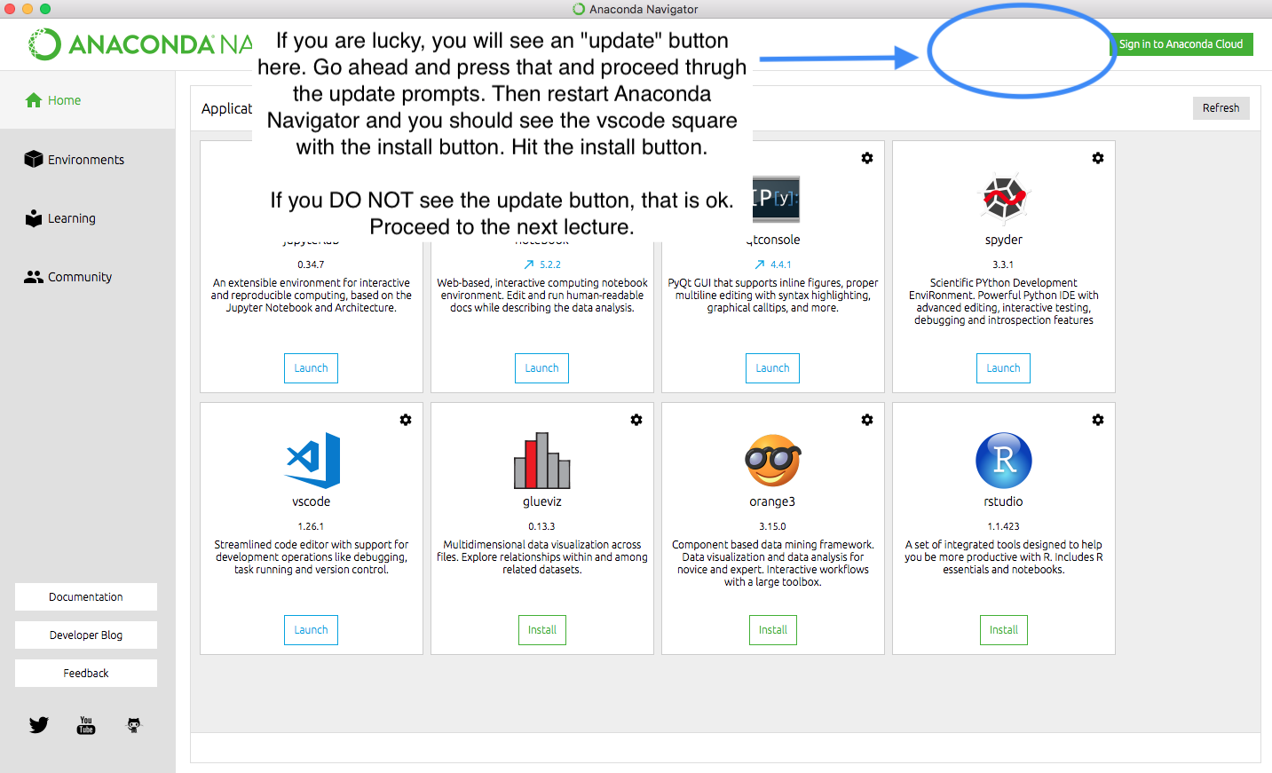
Updating Anaconda Navigator

